Slide 2
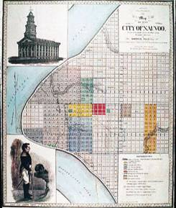
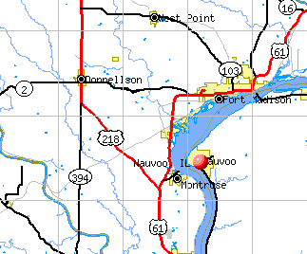
Nauvoo was Well Planned
Big square blocks
just like Salt Lake City
Temple in the center of town
just like Salt Lake City
Businesses and Churches
in the center of town
just like Salt Lake City
Homes built around the downtown
just like Salt Lake City
Farms on the outskirts of towns
+100’s of acres in Iowa
just like Salt Lake City

